Slide 1
Lab 11: Forecasting-Numerical Weather Prediction
Hannah Daley

Slide 2
GFS vs NAM
Global Forecasting System (GFS):
every 6 hours
entire globe
Many models use as initial data (first guess)
North American Model (NAM):
Perturbed from GFS
Only over North America
Higher resolution
How to interpret:
Measures isobars, precipitation, and thickness
Thickness of atmosphere -> dashed lines
Warm temperatures mean expansion, thus higher thicknesses
Close thickness lines means strong temperature gradient (cold or warm front)

Slide 3
How to locate a cold front on GFS or NAM?
Thickness lines close (Steep temperature gradient)
Typically Low pressure system
Typically Heavy amounts of rain

Slide 4
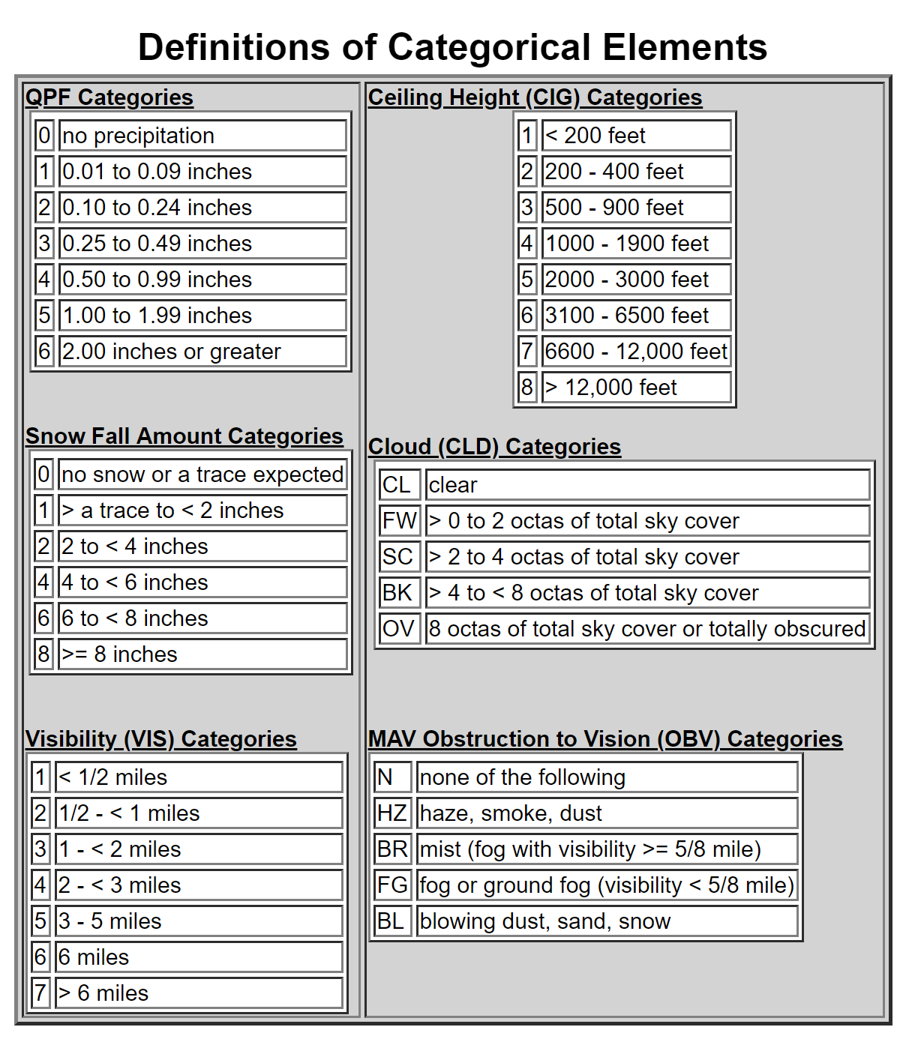
Model Output Statistics (MOS)
Used to incorporate ground weather stations into forecasting models to predict surface based weather
Uses statistical analysis to correct for biases in models
You will only use a few component in MOS based GFS/NAM

Slide 5
GFS based MOS
Nov 2
Nov 3
Example:
On November 3 there is a high probability that it will rain (72% prob.) between 6 UTC and 12 UTC. It will likely rain 0.1 to 0.25 inches before noon.
Probability of rain in the past 6 hours (%)
Expected amount of rain in the past 6 hours (see table pg 76)

Slide 6
GFS based MOS
High and Low Temp (F)
November 3rd has a high of 60 F and a low of 54 F. The cloud coverage is mostly overcast with some scattered clouds in the afternoon. The wind speed ranges from 2 to 11 knots through the day with max winds in the afternoon.
Cloud Coverage
Wind Speed (knots)

Slide 7
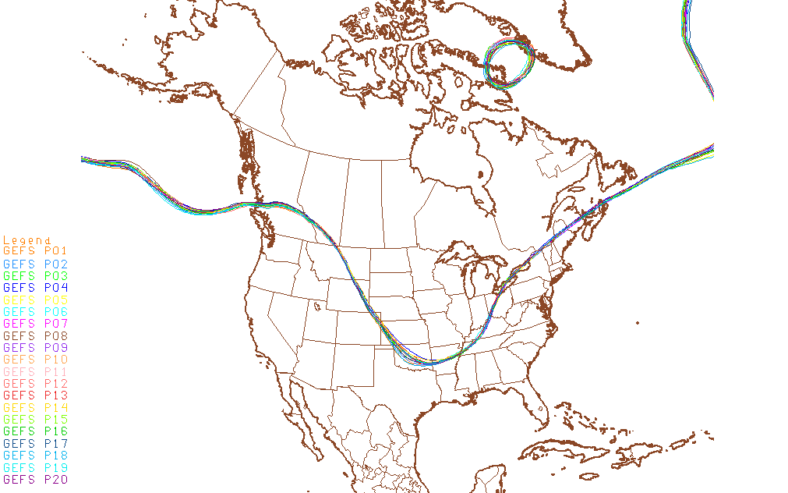
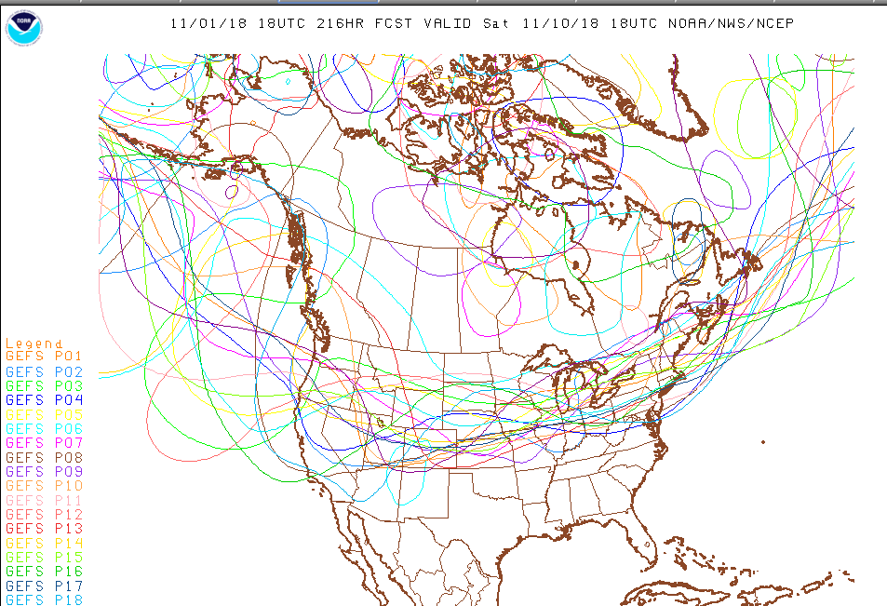
Spaghetti plots
Useful to compare forecasts predicted by a number of differing models (looks like spaghetti)
Increase difference as forecast goes further out in time
Lines are close -> agreement between the models (pictured left)
Lines are far apart -> disagreement between the models (pictured right)

Slide 8
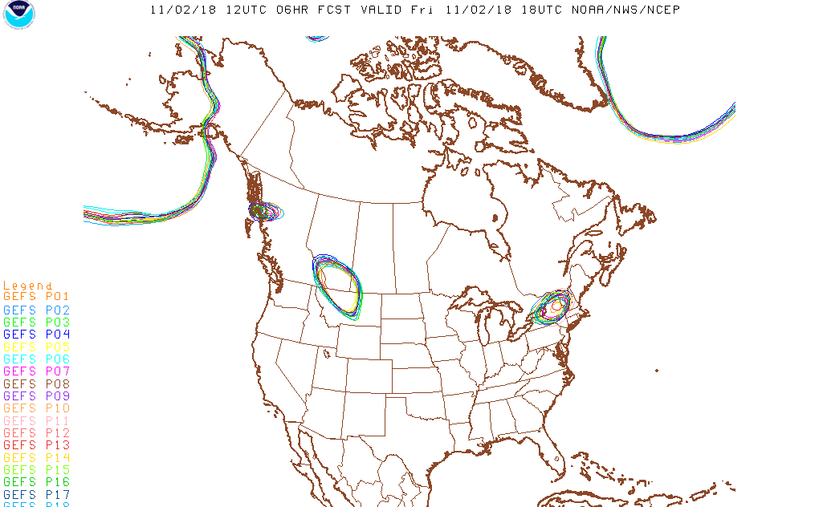
High and Low Pressure Systems

Slide 9
Mean/spread plots (precipitation)
Contour lines are mean values and “filled in colors” are spread
Spread -> how much the value may deviate from the mean (think standard error)
In the figure to the right we can see that college park is predicted to have roughly 1 mm of rain in the next 24 hours

Slide 10
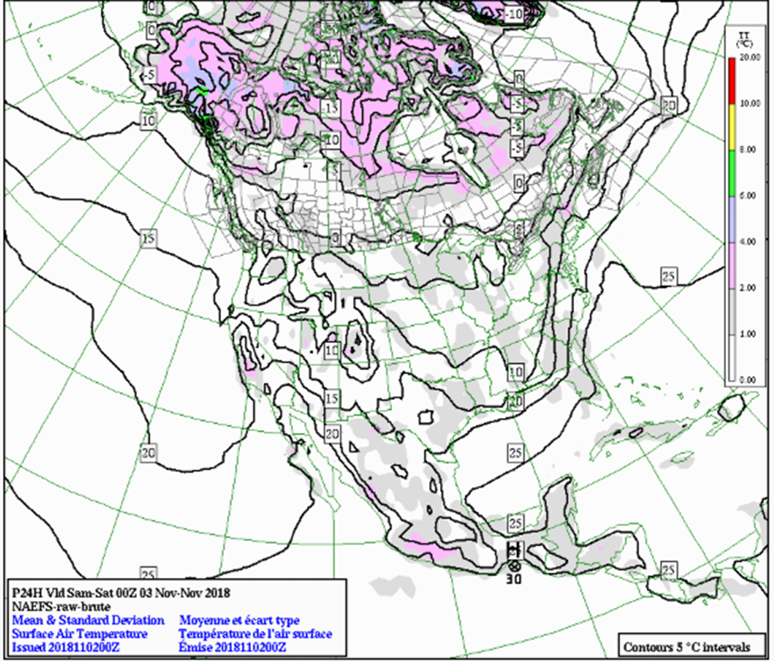
Mean/spread plots (temperature)
Contour lines are mean values and “filled in colors” are spread
Spread -> how much the value may deviate from the mean (think standard error)
In the figure to the right we can see that temperature max for college park is predicted at 15 ֯C +/- 0-1 ֯C

Slide 11
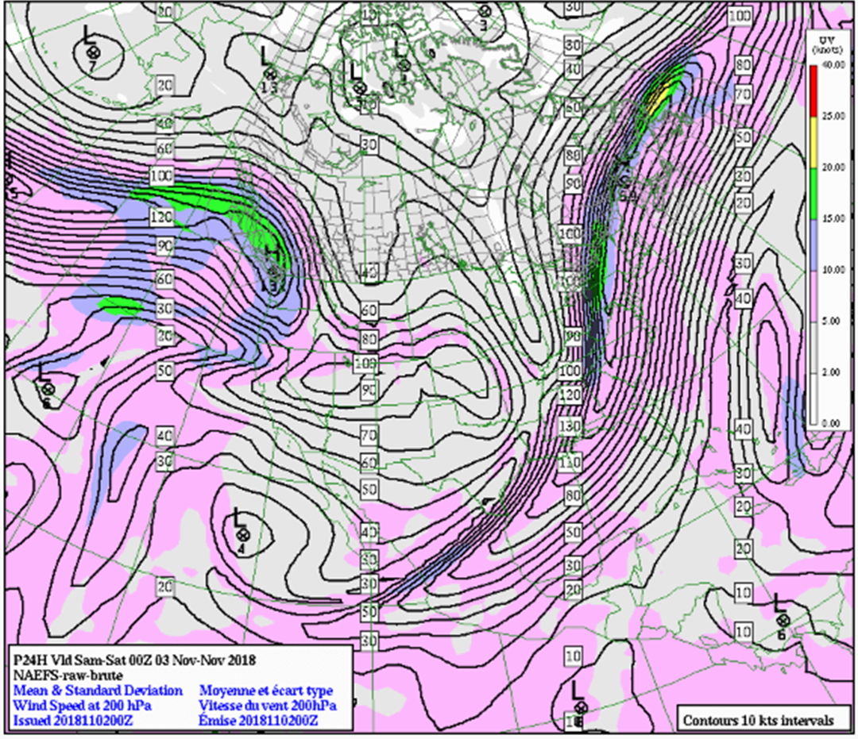
Mean/spread plots (wind speed at 200 hPa)
Contour lines are mean values and “filled in colors” are spread
Spread -> how much the value may deviate from the mean (think standard error)
In the figure to the right we can see that the wind speed for college park (200 hPa) is predicted at 130 knots +/- 5-10 knots

Slide 12
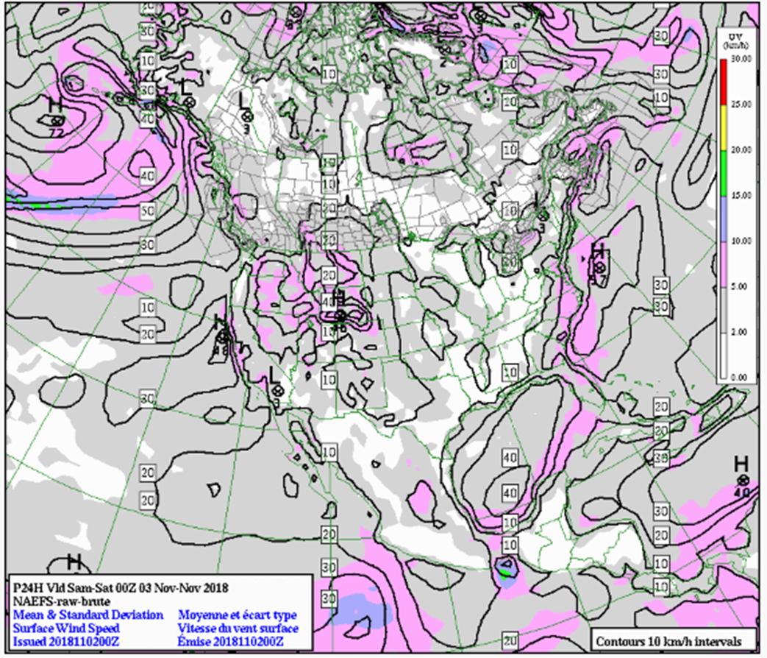
Mean/spread plots (surface wind speed)
Contour lines are mean values and “filled in colors” are spread
Spread -> how much the value may deviate from the mean (think standard error)
In the figure to the right we can see that the wind speed for college park is predicted at 10-20 +/- 5-10 km/hr

